Slide 1



M I L E S T O N E
I N S U R A I
Presented by – D.Firoza Sulthana

Slide 2


Introduction
The updated dashboard introduces a language selector, allowing employees to switch between English, Hindi, Telugu, and Tamil for better comfort and localization. A new accessibility control lets users adjust font size (A– / A+), improving readability for all vision levels. The claim journey tracker visually maps each claim stage from Submitted to Paid, highlighting the current step for instant status awareness. Together, these enhancements make the InsurAI Employee Portal more user-friendly, inclusive, and transparent in day-to-day claim management.

Slide 3
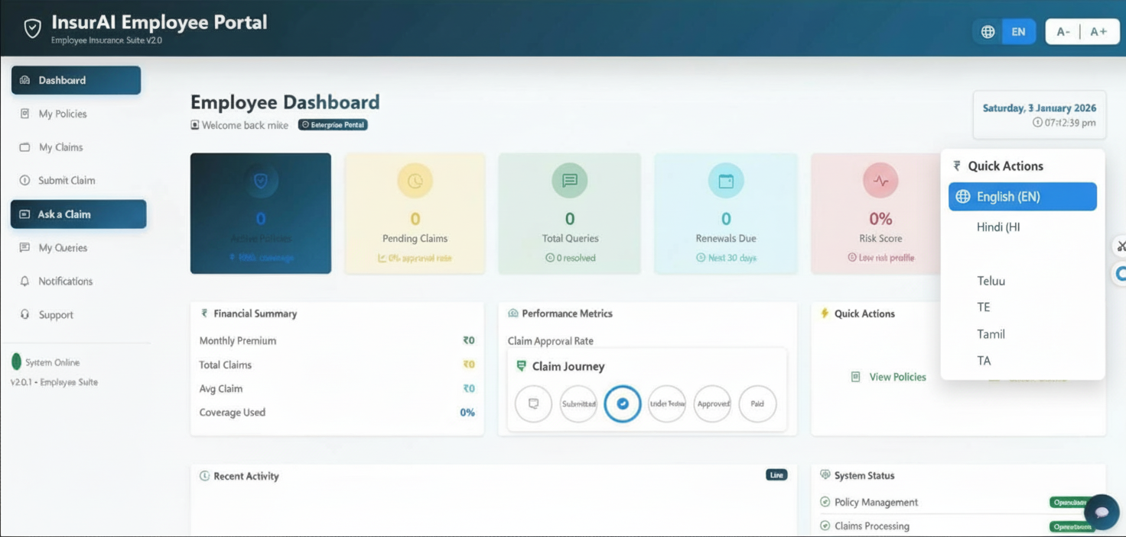

UI FEATURES
Language selector UI
Globe icon with a rounded dropdown showing options like English, Hindi, Telugu, and Tamil.
Selected language is highlighted with a blue background, while others use neutral colors for contrast.
Accessibility (font size) controls
Compact pill-style toggle labeled A– and A+ to decrease or increase text size.
Positioned in the top bar so users can adjust readability from any screen without navigating away.
Claim journey tracker widget
Horizontal stepper with circular icons for each stage: Submitted, Under Review, Approved, Paid.
Current step is emphasized using filled blue circle, bold label, and connecting progress line for quick visual status recognition.

Slide 4
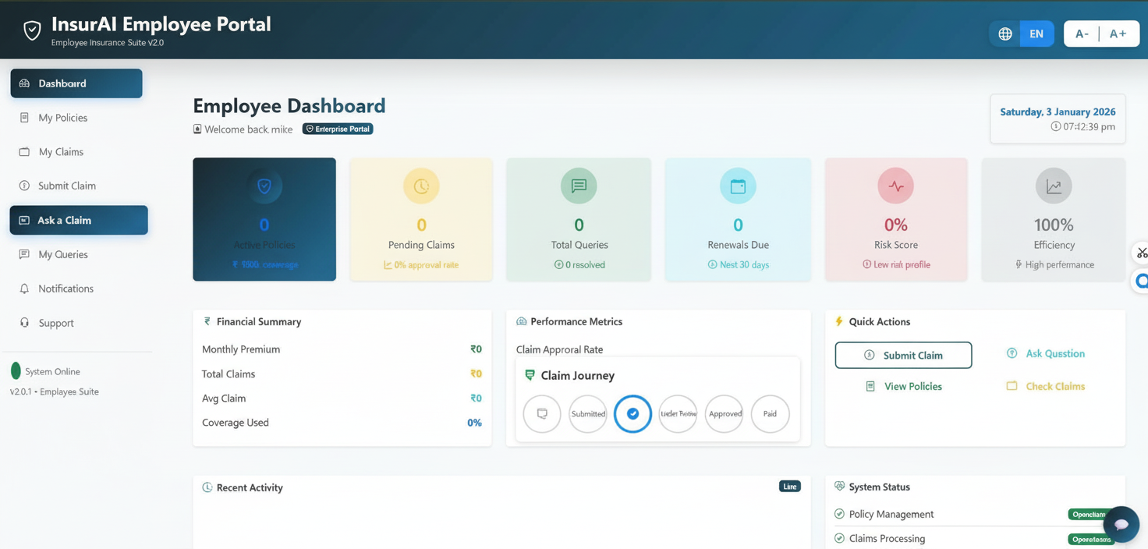
EMPLOYEE DASHBOARD

Slide 5
EMPLOYEE DASHBOARD

Slide 6
FRONTEND CHANGES
Header bar changes
Added globe icon with “EN” language dropdown control in the top-right header.
Added accessibility pill button with “A- | A+” font-size toggles next to the language selector.
Claim journey widget
New “Claim Journey” section added inside the Performance Metrics area/card.
Horizontal stepper UI with four circular steps (Submitted, Under Review, Approved, Paid) and a blue-highlighted current step.
Visual/interaction refinements
Cards use slightly stronger shadows and spacing to improve separation between sections.
Active sidebar item (“Ask a Claim”) and quick action buttons styled with clearer focus/highlight states.​

Slide 7
Benefits:
✅ Multi-language support - Employees can view dashboard in their preferred language ✅ Accessibility - Font size adjustment for better readability ✅ Claim transparency - Employees know exactly where their claim stands at any time ✅ Modern UX - Clean, organized layout with visual progress indicators

Slide 8
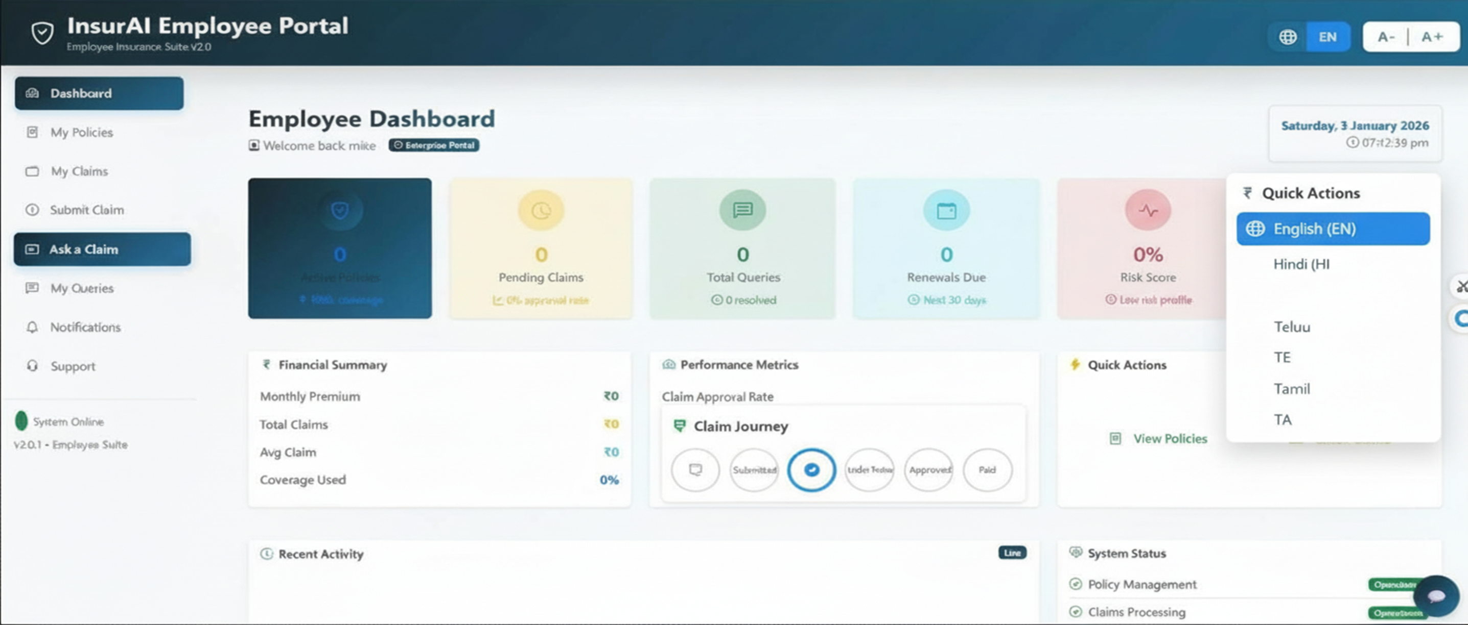
What Changed :
✅ Language Dropdown in top bar (English, हिंदी, తెలుగు)
✅ Font Size Toggle (A−, A, A+) with active state
✅ Claim Journey Tracker showing 4 steps (Submitted → Under Review → Approved → Paid) with visual progress
✅ Enhanced header with greeting and context
✅ Reorganized layout with KPI strip, Overview + Quick Actions side-by-side
.
.

Slide 9
Thank You

